Slide 1
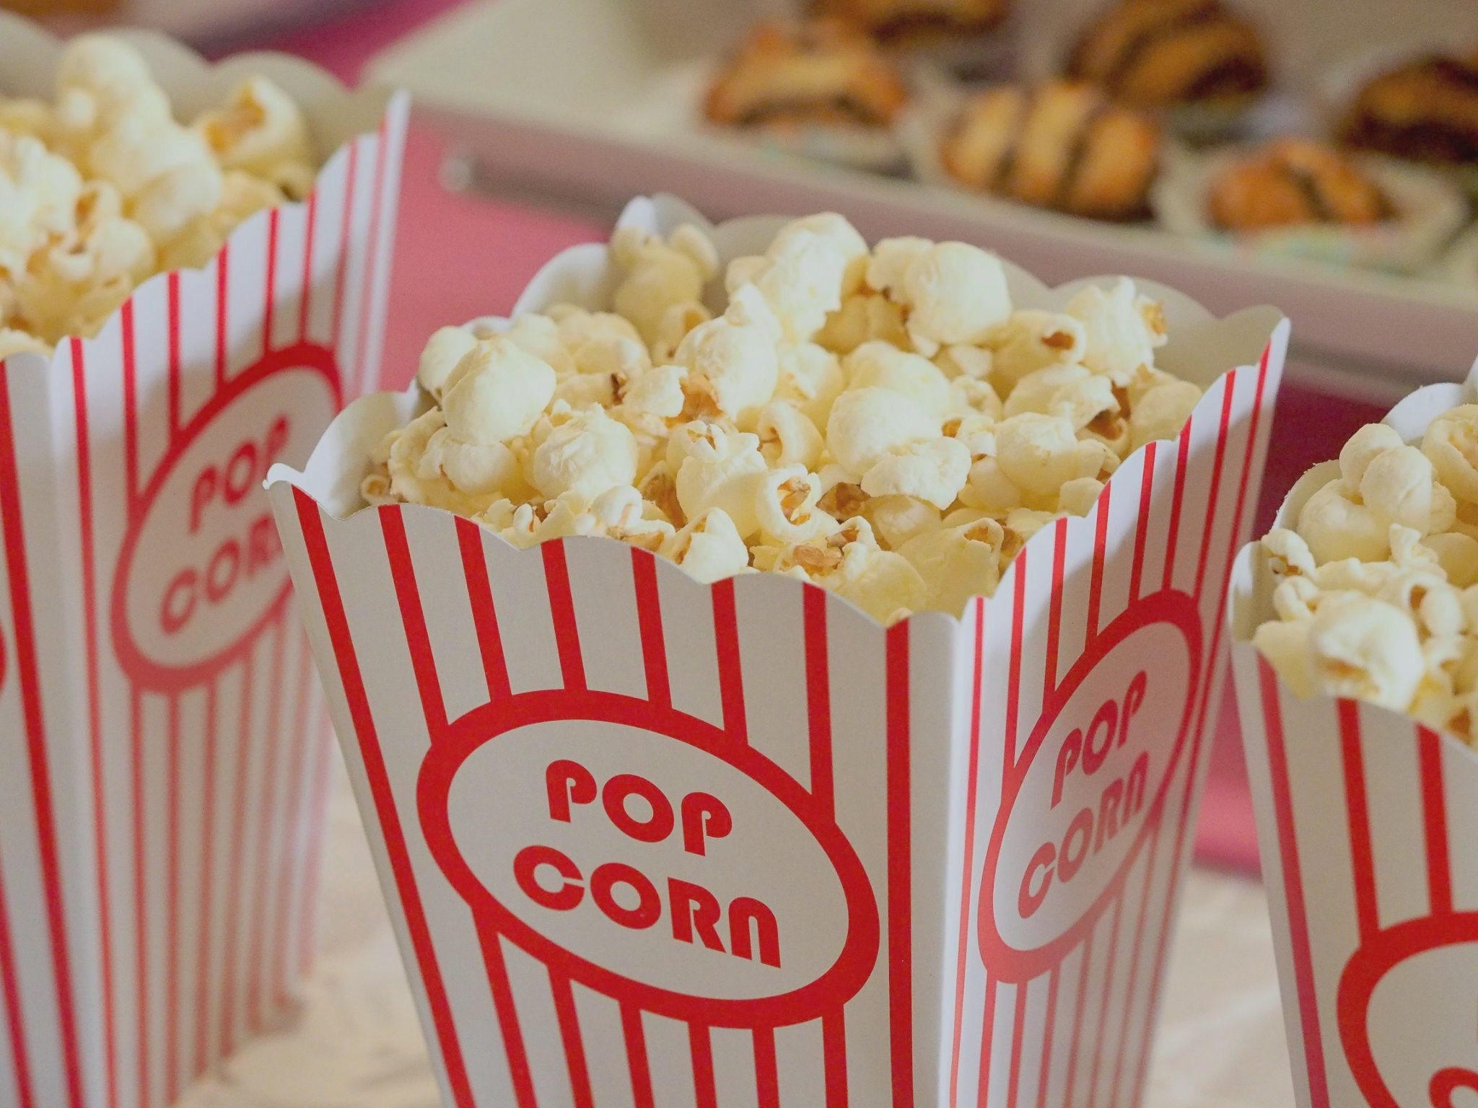
Movie Recommendation Systems
Group 3
Notes:
Byron
We started with a question, Why is Netflix recommending me garbage?

Slide 2
Questions we want to answer
Why did we select this topic?
Can we accurately predict movie recommendations for users based off their previous ratings?
What is the best Machine Learning model for this purpose?
Saturated streaming video marketplace
A large dataset available to work with
Notes:
Byron
Our Question: Can we accurately predict and recommend movies based off of someone’s own actual previous recommendations?
Follow up Question: What is the best model to use for this?
Why did we select this topic?
Effective recommendation systems increasing problem in today’s saturated streaming marketplace
Ample data available to tackle this issue

Slide 3
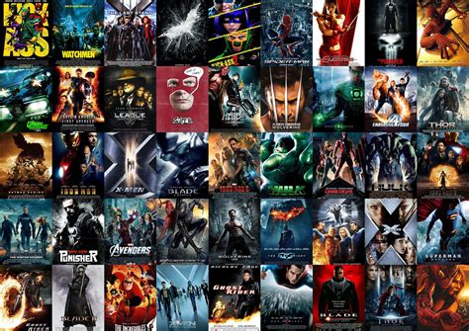
Data Source
25,000,000 ratings
209,171 movies
162,541 MovieLens users
Notes:
Byron
MovieLens has multiple different datasets dealing with movies and user recommendations.
We decided to be ambitious and went with the largest with has 25 million reviews of over 209 thousand movies by over 162 thousand users.

Slide 4

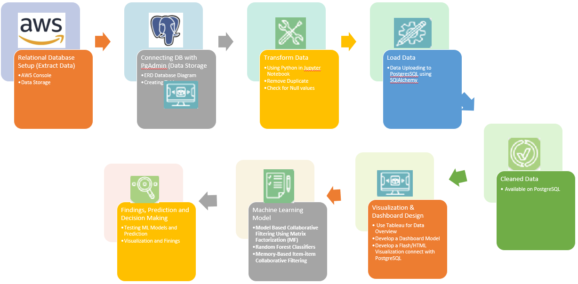

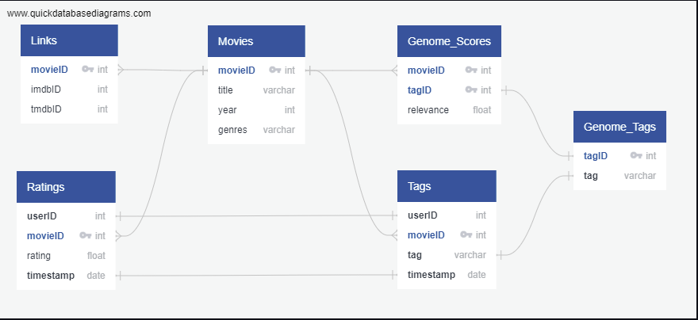
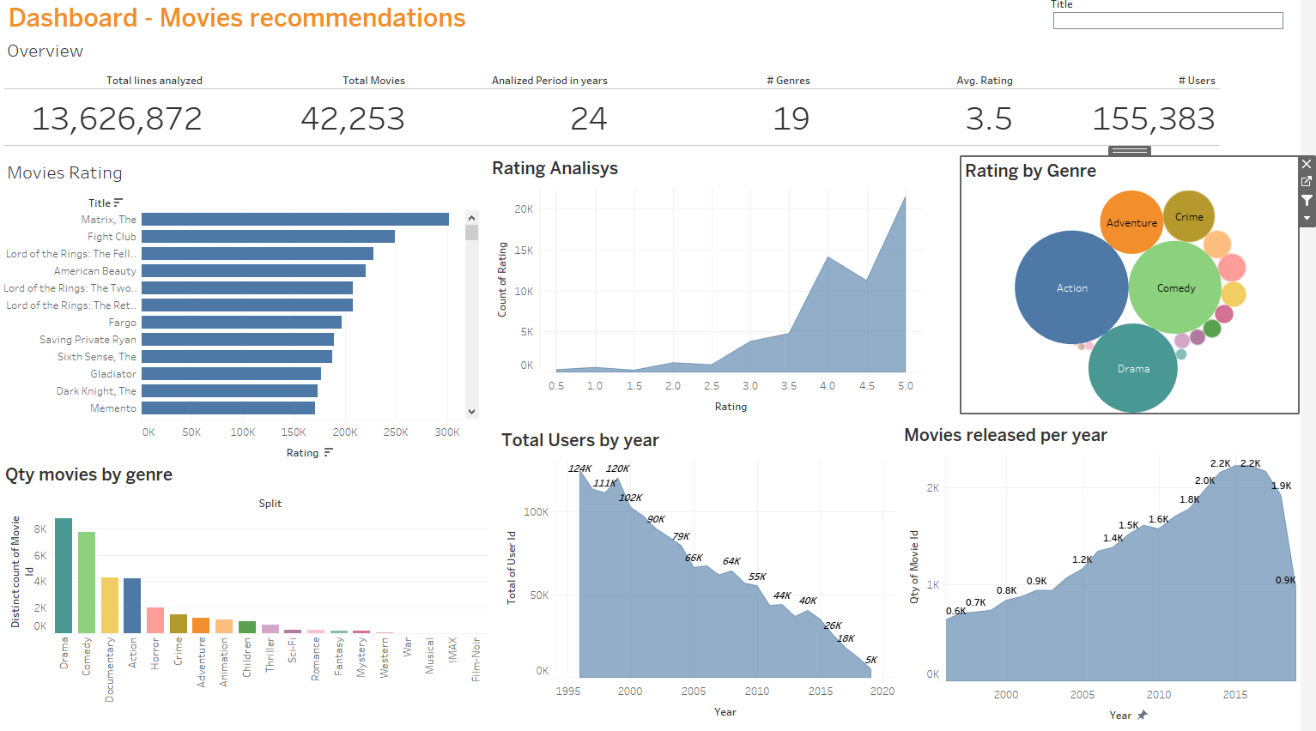
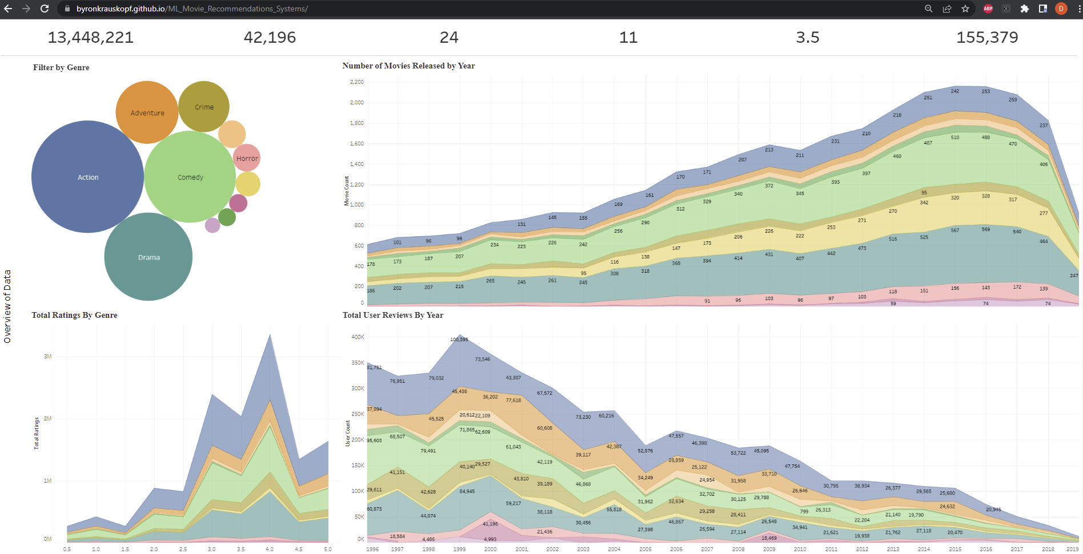
Data Pipeline & Data Preprocessing
Notes:
Byron
Data came already in multiple related tables so we made the decision to store our data in the RDBS PostgresSQL hosted on AWS.
During ETL and Data Preprocessing:
dataset is absolutely massive, too large for our computers to efficiently handle
business decisions: 1) drop any movies rated by less than 100 users
2) drop any users that rated less than 100 movies

Slide 5










Technologies, Languages and Tools
ML Model 1
ML Model 2
Model Based Collaborative Filtering Using Matrix Factorization (MF)
The model learns the latent preferences of users and the latent attributes of items from known ratings to find similarity and make a recommendation
Test K-means Clustering model
This algorithm is an iterative calculation that segments the dataset as indicated by their elements into K number of predefined non- overlapping distinct clusters or subgroups
Notes:
constellation of technologies including AWS, PostgreSQL, python, flask, html, Google Colab, Tableau and of course our two models

Slide 6
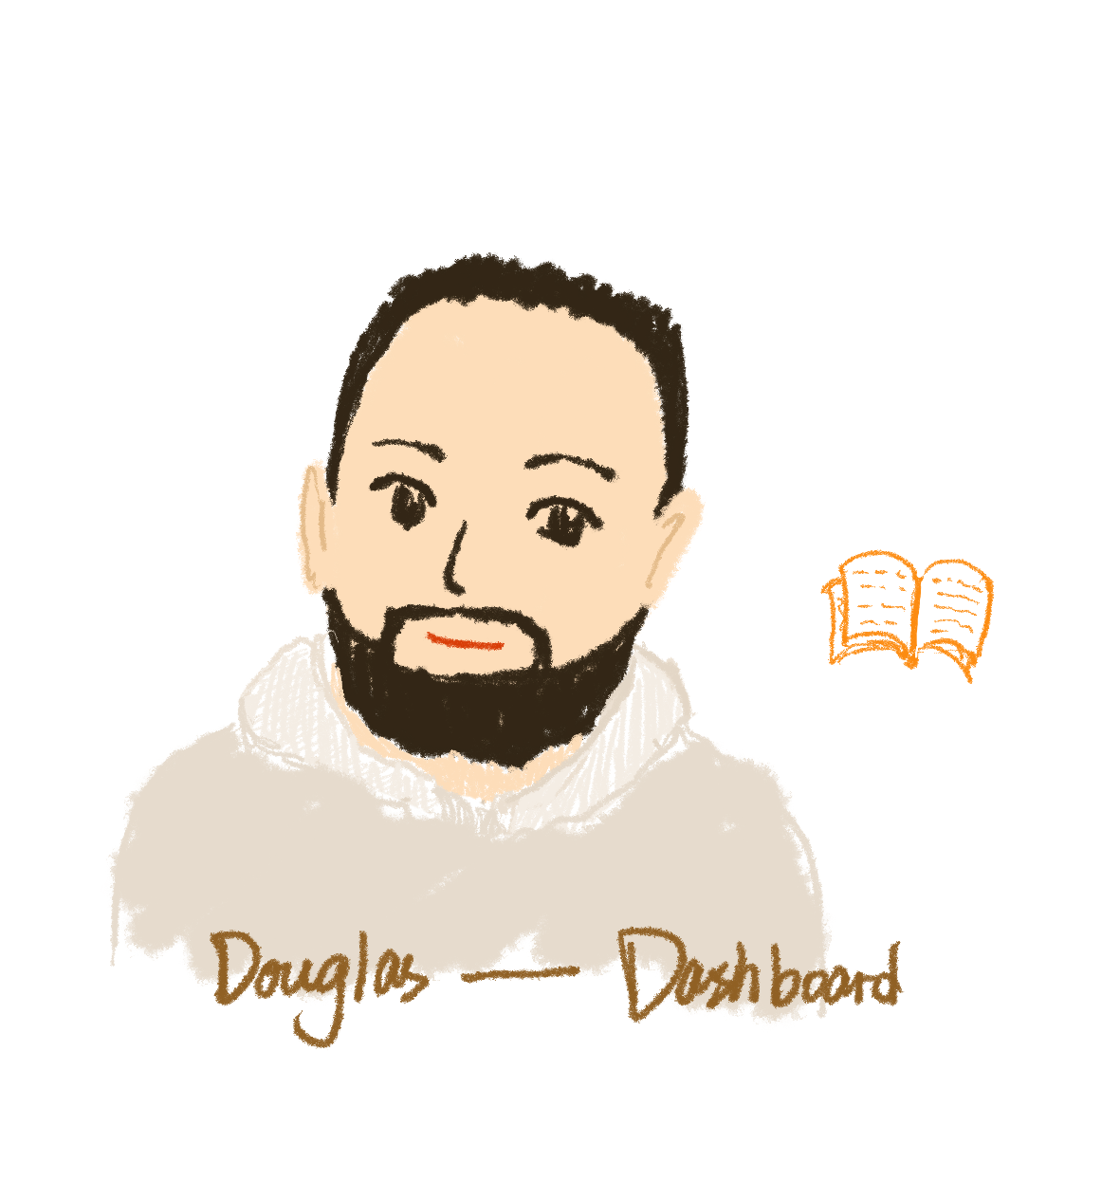
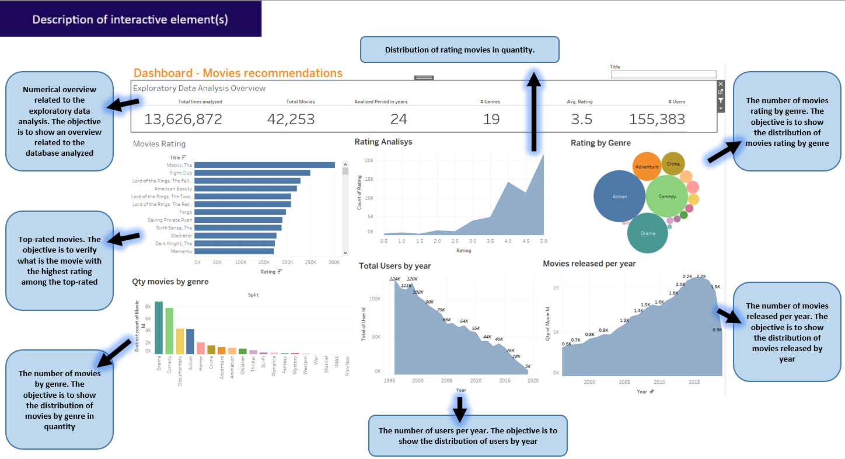
Tableau Dashboard - Exploratory Data Overview
Hyperlink access the tableau visualization: https://public.tableau.com/app/profile/douguot/viz/MoviesRecommendations/DashboardOverview?publish=yes
Notes:
We used Tableau to create our dashboard (with database overview). Due the limitations of Tableau, we loading around 13MM lines vs 25 MM from the original database.
To fix the Tableau limitation, we create a table on SQL, filtering the year of the movies. We used 24 years of movies.
The dashboard above is interactive. We include a tableau feature (hyperlink for movie titles). So click on any movie title, and a new window will be open on the IMDb website with more information about the movie selected.
After the ETL process, the group used Tableau to run an exploratory data analysis on the dataset and to visualize our findings. Initially, we created a worksheet with several graphs and specific studies. Then, we prepared a dashboard to visualize the findings in an efficient and elegant manner.

Slide 7
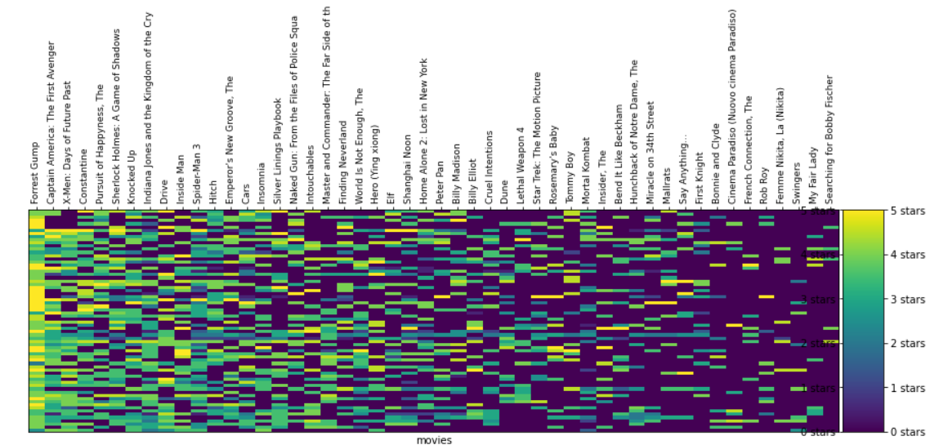
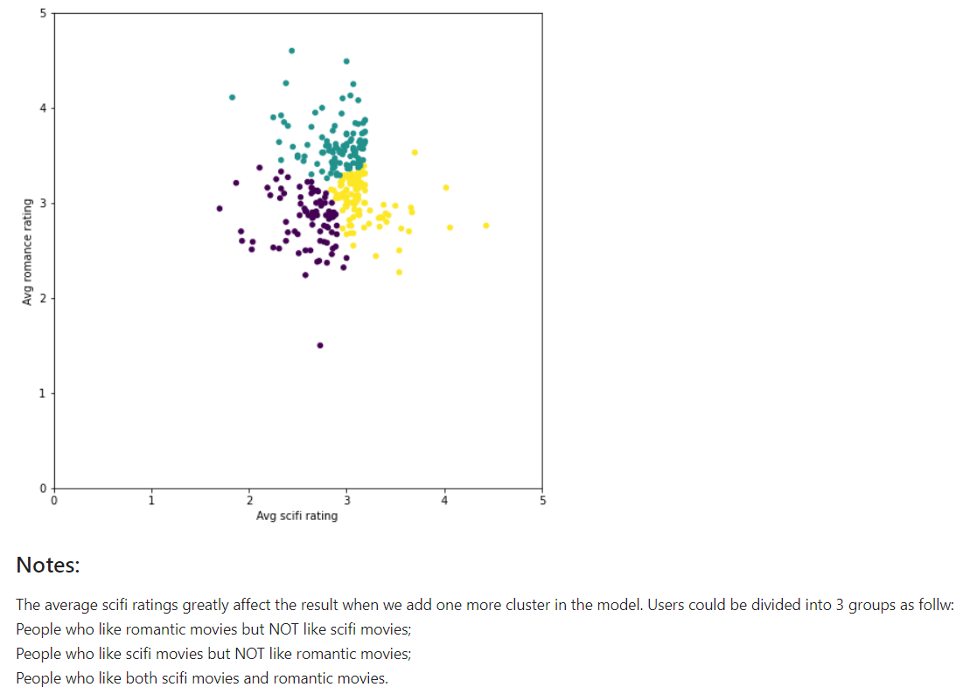
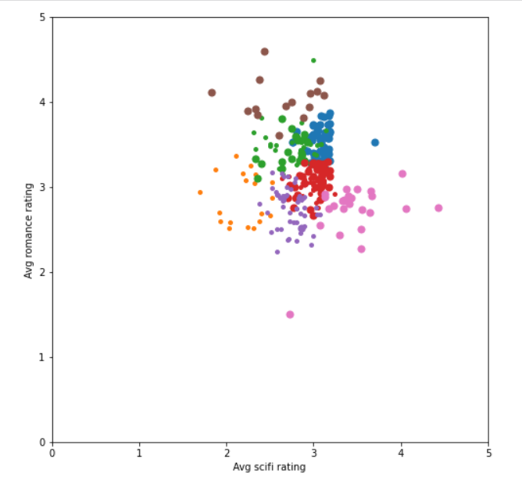
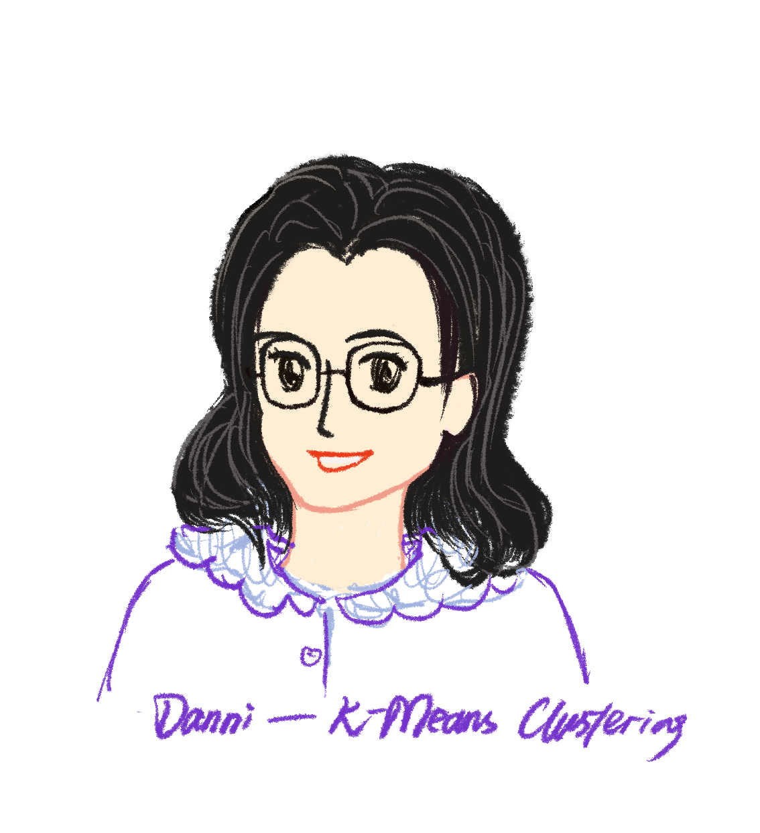
Result of the analysis - Test K-means Clustering model
K-means Clustering is an unsupervised learning algorithm used to identify and solve clustering issues.
Features: Userid, movie ratings, genres.
Notes:
K represents how many clusters there will be. These clusters are then determined by the means of all the points that will belong to the cluster.
I tried Random Forest first since this supervised machine learning model is robust and explainable. But due to the lack of features, such as user information (age, nationality, address etc.) and movie details (director, producer, company, leader actor/actress etc.) I found it might not be a suitable choice for our case. Thus I tried any unsupervised model which I am familiar with and finally decide to use K-means Clustering.

Slide 8
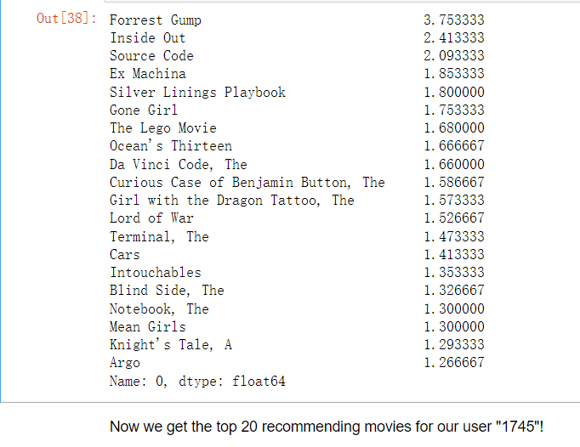
Predictions Rules & Results
Since the user is in a cluster of users that seem to have similar taste, we can take the average of the votes for that movie in this cluster, and that would be a reasonable prediction for much he/she would enjoy the movie.
Notes:
As per this logic, if we calculate the average score in this cluster for every movie, we would have an understanding for how this 'taste cluster' feels about each movie in the dataset.

Slide 9
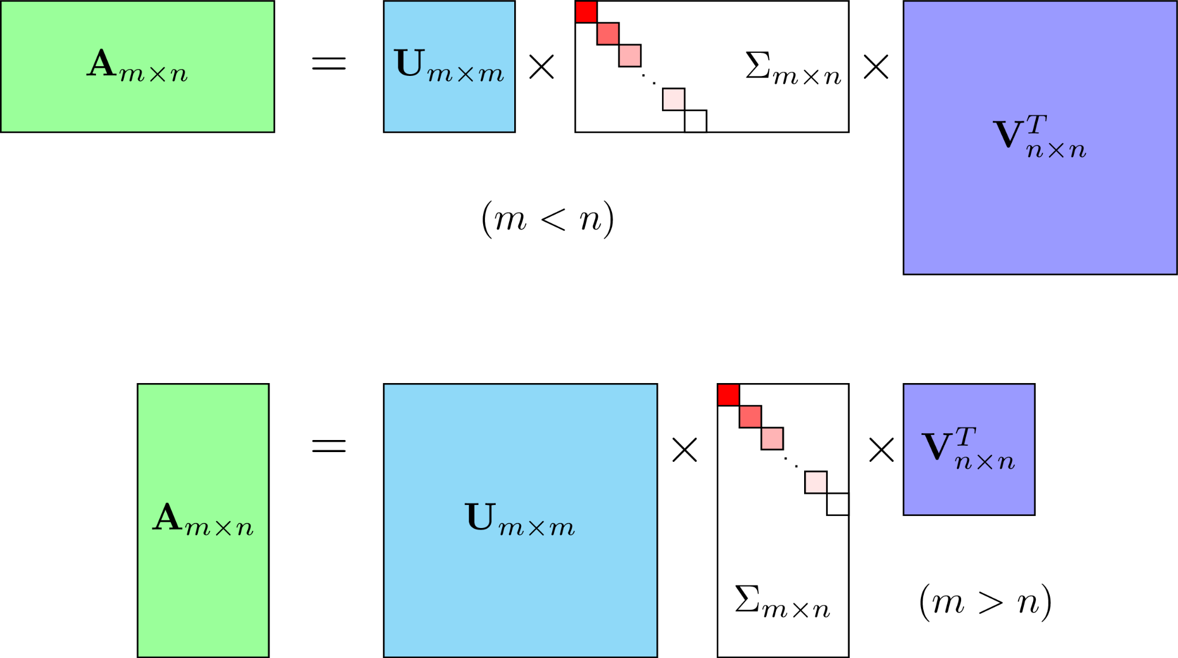
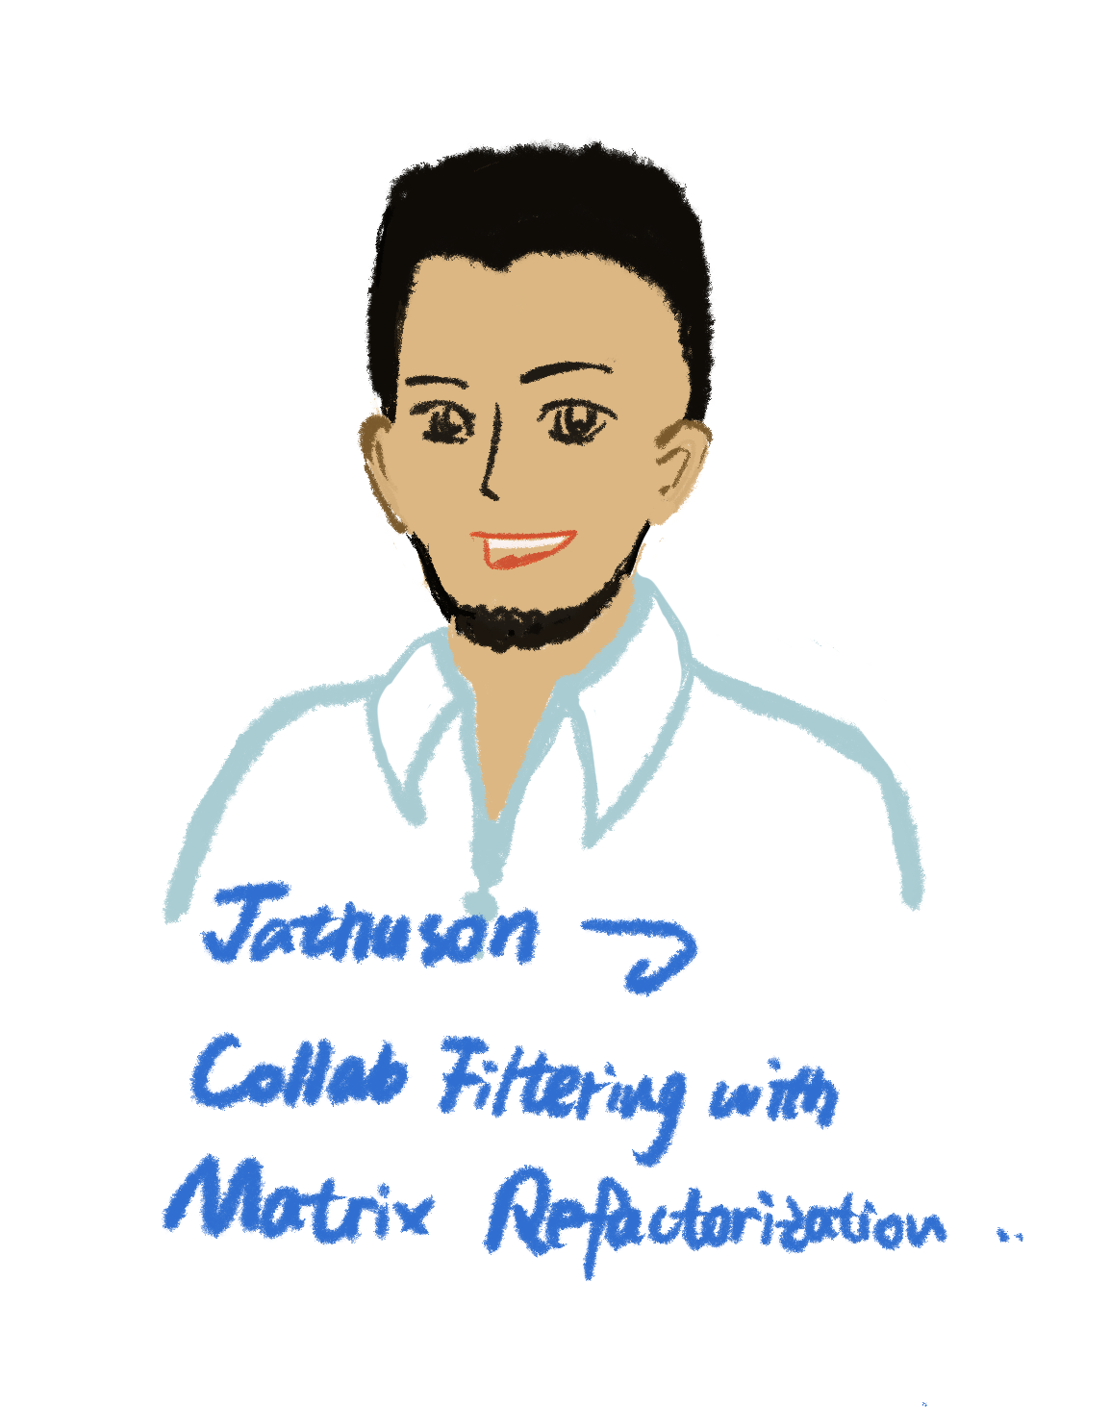
ML Model - Model Based Collaborative Filtering Using Matrix Factorization (MF)
How the Model Works
Unsupervised machine learning model
Collaborative filtering method that finds the relationship between items and users’ entities.
The model learns the latent preferences of users and the latent attributes of items from known ratings to find similarity and make a recommendation.
The model uses low-rank matrix factorization to derive the preferences from the dataset.
The model uses Single-Value Decomposition (SVD) to derive the low-rank matrix. From there, this matrix is used to predict the ratings of the remaining movies for each user.
Features
UserId, MovieId
Assumptions & Conditions
Filtered out users with less than 100 ratings
Filtered out movies with less than 100 ratings
Notes:
Matrix factorization is the preferred model for recommender systems since it can deal with scalability and sparsity better than Memory-based collaborative filtering

Slide 10

Final Results: K-Means Vs. Matrix Factorization
K-Mean had inconsistent results due to the need to replace NaN values with 0 in the matrix
Collaborative Filtering resulted in a Root Mean Square Error (RMSE) of 0.8057
This is less than the ideal of 0.9 but still acceptable
We recommend using Collaborative Filtering Using Matrix Factorization

Slide 11
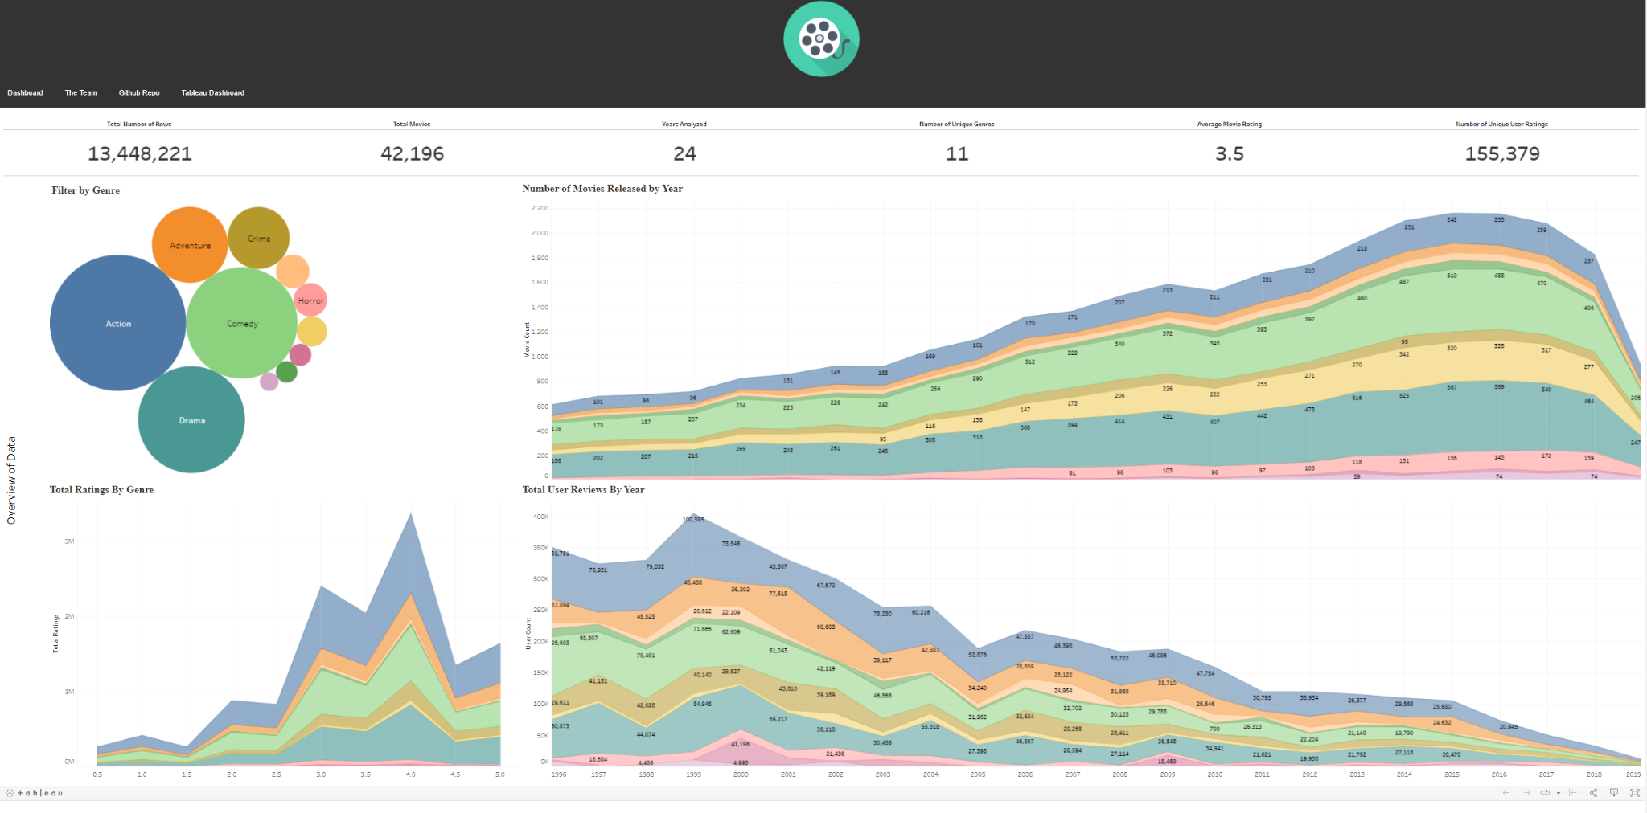
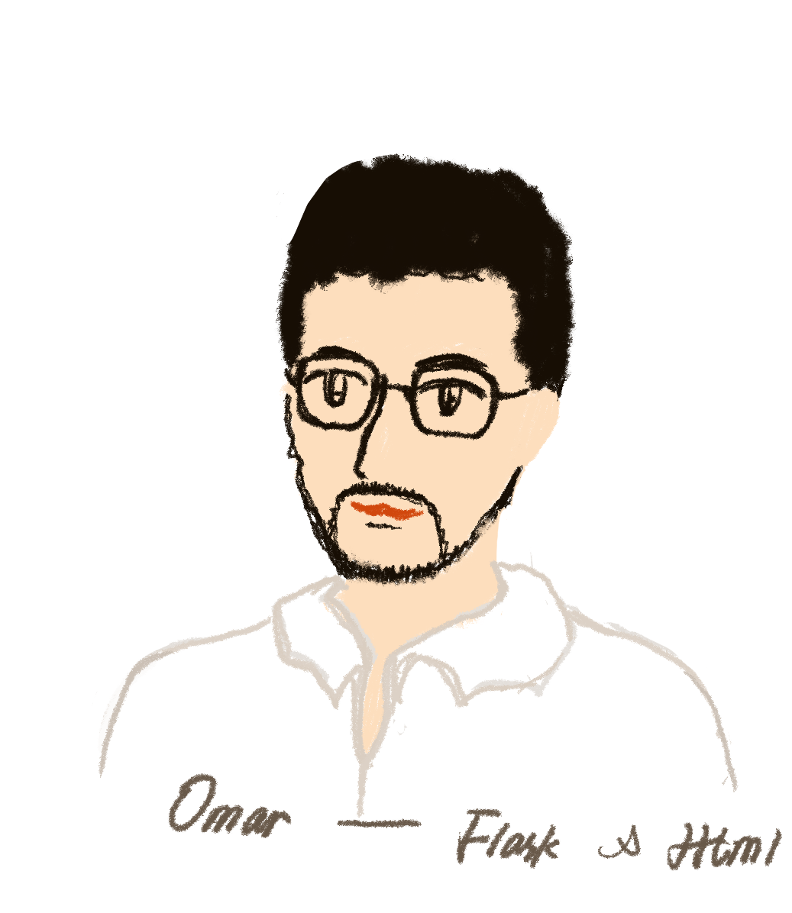
Dashboarding
Flask was used to connect our models and web scraping to the HTML dashboard
Exploratory data taken from Tableau
Live Demo!
Notes:
We used a combination of flask and html to create our data analytics dashboard. We will be having a live demo of our website at the end of the presentation.

Slide 12
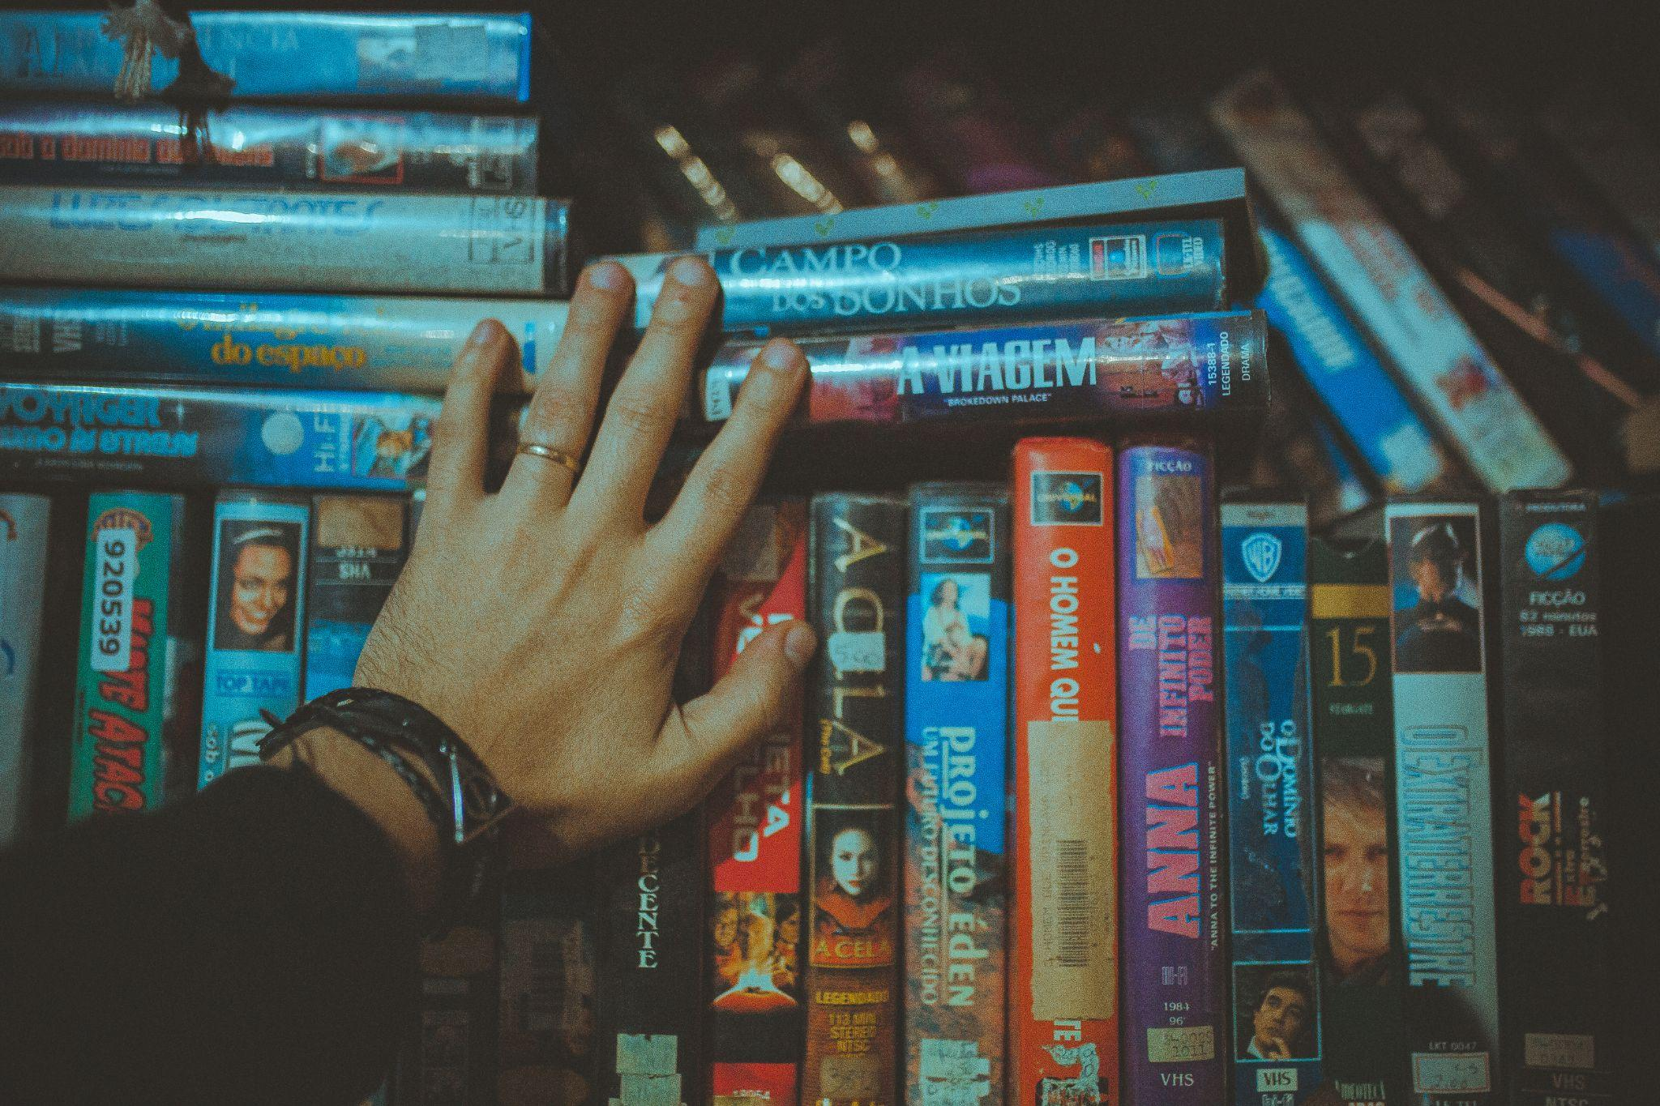
Recommendation for future analysis
Append new datasets
Demographic information:
age
nationality
gender
Reason: Allows analysis to account for demographics, and adds another layer of complexity to the machine learning models.
Notes:
For a future analysis, we recommend the use of a dataset containing more information related to the users demographics. This will add a new level of complexity to our machine learning models and allow for more comparisons.

Slide 13

Limitations & Challenges related to the project
Database: MovieLens Dataset does not contain additional information related to users, limiting the variables for recommending movies.
Big Data: The database used contains more than 25MM lines. The tableau for example can only load up to 15MM. Jupyter Notebook also has limitations for Big Data, using Python and Pandas.
Machine Learning: Some Machine Learning models may not be effective for use in recommending movies, making it necessary to research other more efficient models.
Notes:
Some of the limitations that we faced while working on this project can be broken down into three categories:
As mentioned before, the dataset we used for our study does limits the level of complexity our machine models can run and we would preferably like to have some information regarding user demographics.
Both our hardware and software had difficulty working with the huge dataset we used for our machine learning models. We were able to tackle this limitation by aggregating our data into smaller chunks and perform a parallel process when running our models.
The Kmeans model was unable to accurately give movie recommendations for the users we analyzed. The recommendations that the model tried to give as well were not consistent with previous trails we ran.

Slide 14
Live Demo
Notes:
The first thing the user sees when they enter our website is the exploratory data analysis. Users are able to filter through the data using the movie genres. The charts are responsive and allow for some interactivity with the user. When a user enters a userid in this form here, five movies are recommended for that particular user. In this case the movies are being recommended for user id #1.

Slide 15
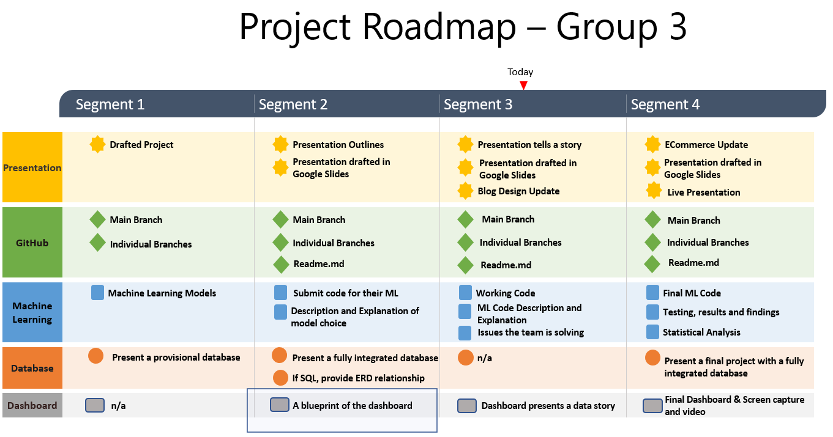
Notes:
Byron
Probably don’t need this slide, it can be hidden in presentation.

Slide 16
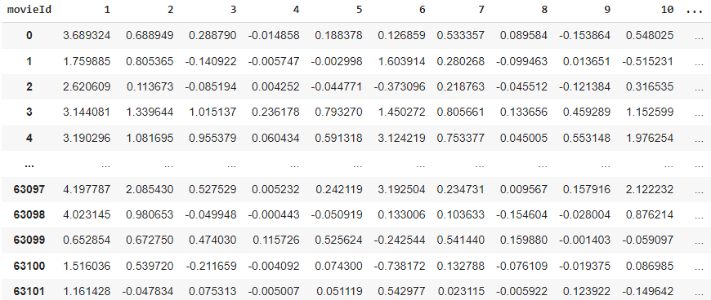
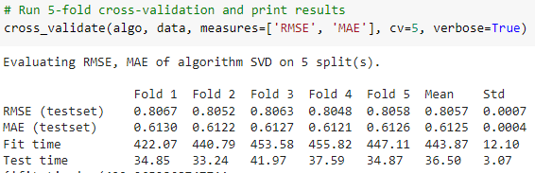
Results of the MF Model
Output of Model:
Matrix with predicted ratings for movies by each user
Built a function that lists 20 recommended movies for a given user
Accuracy of the Model:
Average RMSE of 0.8057
Notes:
should i add improvements here?

Slide 17
Notes:
Scatter plot is not suitable to display 20 features…

Slide 18
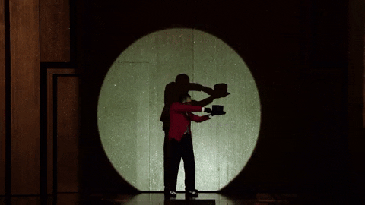
Why did we select this topic?
Saturated streaming video marketplace
A large dataset available to work with
Notes:
Byron
Increasing problem in todays saturated streaming marketplace
Ample data available to tackle this issue
Customers: everyday users looking for better recommendations, movie streaming companies looking to improve their recommendations to their users

Slide 19
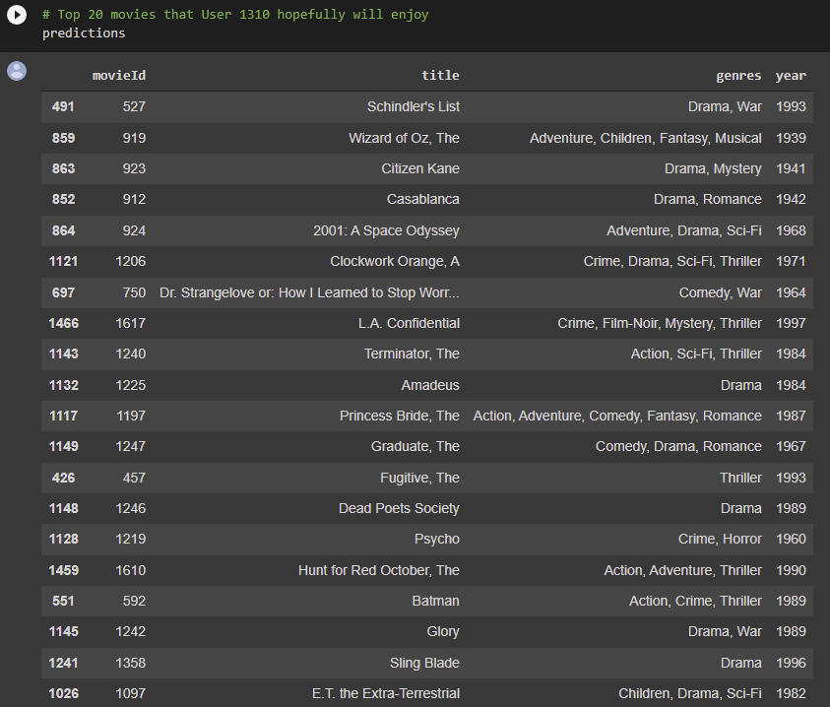
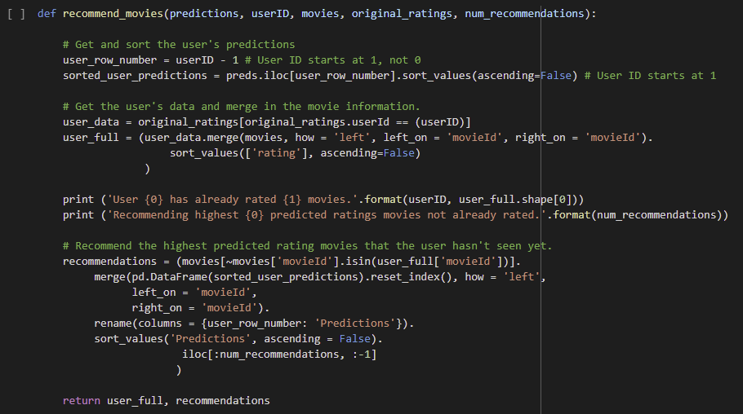
ML Model - Model Based Collaborative Filtering Using Matrix Factorization (MF)
The model is a collaborative filtering method that finds the relationship between items and users’ entities. The model learns the latent preferences of users and the latent attributes of items from known ratings to find similarity and make a recommendation. The model uses low-rank matrix factorization to derive the preferences from the dataset. Matrix factorization is the preferred model for recommender systems since it can deal with scalability and sparsity better than Memory-based collaborative filtering
Description of feature engineering: The decision making
process is
- Get and sorte the user's predictions
- Get the user's data and merge in the movie information
- Recommend the highest predicted rating movies that the user hasn't seen yet.
Using the ID User 1310 the model predicts a list of movies that this user hopefully will enjoy

Slide 20
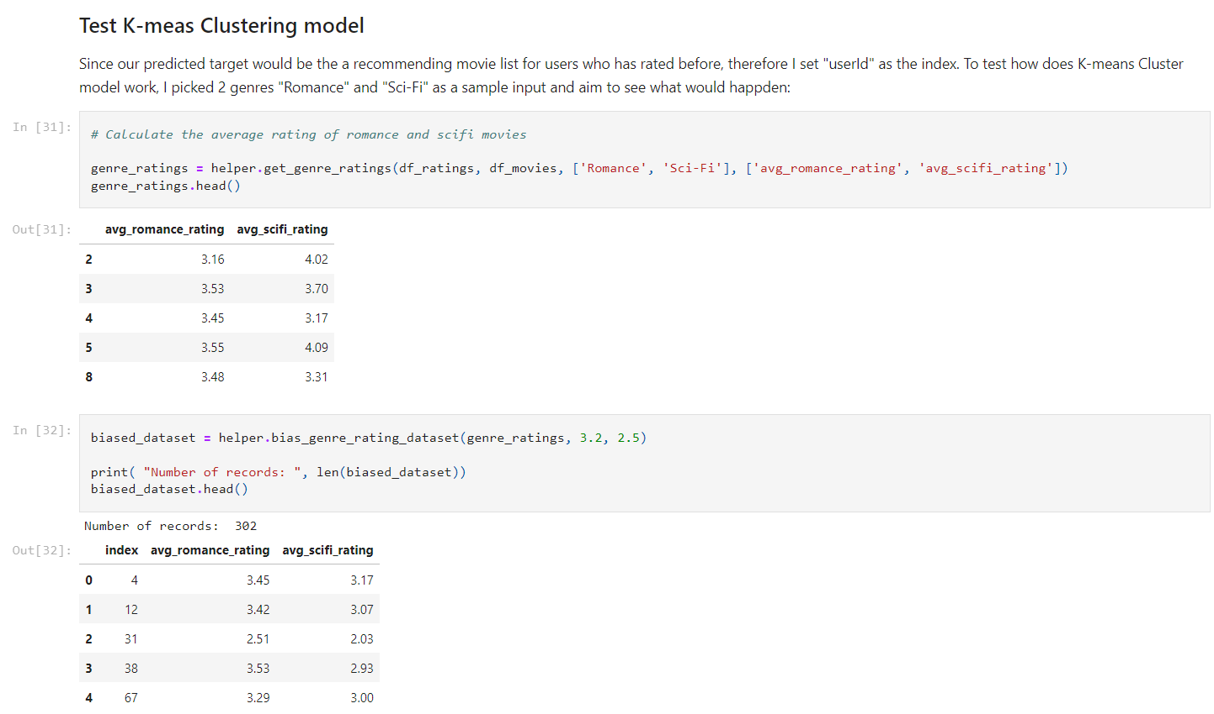
Notes:
Since our predicted target would be the a recommending movie list for users who has rated before, therefore I set "userId" as the index. To test how does K-means Cluster model work, I picked 2 genres "Romance" and "Sci-Fi" as a sample input and aim to see what would happen.

Slide 21


Description of the tool that will be used to create the final dashboard
After the ETL process, the group used Tableau to run an exploratory data analysis on the dataset and to visualize our findings. Initially, we created a worksheet with several graphs and specific studies. Then, we prepared a dashboard to visualize the findings in an efficient and elegant manner.
Notes:
We did a Exploratory Data Analysis (EDA) in order to investigate the data set summarize and provides a better understanding of data set variables and the relationships between them.
The importance of EDA is to help identify obvious errors, as well as better understand patterns within the data, detect outliers or anomalous events, find interesting relations among the variables

Slide 22
Notes:
20 heat map to show 20 genres separately, each cell shows the ratings of a user for a specific movie, we group the users with similar ratings together and make predictions

Slide 23
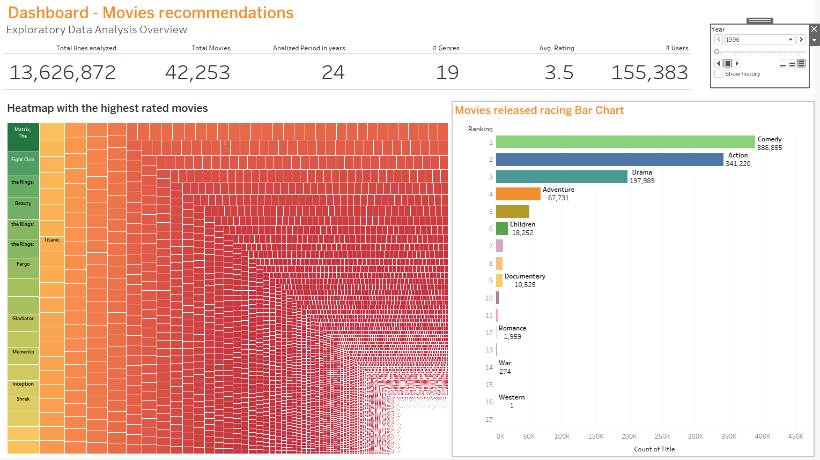
Tableau Dashboard - Heatmap and movies released racing bar chart
Hyperlink access the tableau visualization: https://public.tableau.com/app/profile/douguot/viz/MoviesRecommendationsHeatmapandracingbarchart/Dashboard2?publish=yes
Hyperlink access the tableau Story: https://public.tableau.com/app/profile/douguot/viz/MoviesRecommendationsStory/Story1?publish=yes
Notes:
The first graph is with heatmap (by highest rating movie according to the database), which also includes the same tableau feature (hyperlink for movie titles).
The second is a racing bar chart racing, showing the number of movies by genre released year by year. To use this Tableau feature, just by clicking on the play button on the Tableau website (see hyperlink below the dashboard)
Last, we have prepared a story on the Tableau, summarizing the main google slides on the Tableau. The story on Tableau is an excellent alternative to the google slide for a presentation because we can use the features and interactivity on the tableau website. (See hyperlink below the dashboard)

Slide 24
References
https://grouplens.org/datasets/movielens/
https://www.ibm.com/cloud/blog/supervised-vs-unsupervised-learning
https://www.quickdatabasediagrams.com/
https://towardsdatascience.com/the-4-recommendation-engines-that-can-predict-your-movie-tastes-109dc4e10c52
https://www.imdb.com/
https://learnsql.com/blog/how-to-join-3-tables-or-more-in-sql/
https://towardsdatascience.com/8-alternatives-to-pandas-for-processing-large-datasets-928fc927b08c
https://www.ibm.com/cloud/learn/exploratory-data-analysis

